Slide 1
Prokaryotic and eukaryotic cells
Year 11 Biology
Bremer SHS

Slide 2
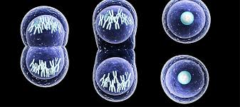
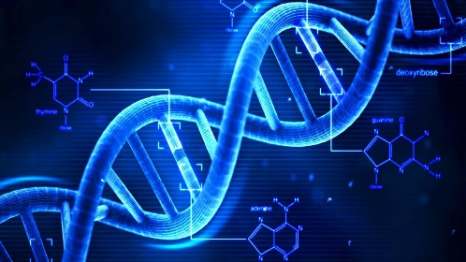

Characteristics of life
Brainstorm: Characteristics of living things.
All living things share certain characteristics:
Cellular organization: the basic unit of structure and function in living things
Metabolism: chemical reactions and energy transfers
Homeostasis: self-regulating mechanisms.
Growth and development: increase in size, number, and function of cells.
Sensitivity: response to environment
Reproduction: the production of new cells
Heredity: a genetic system based on the replication of DNA

Slide 3

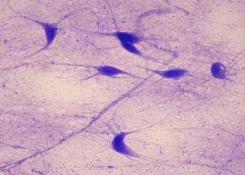
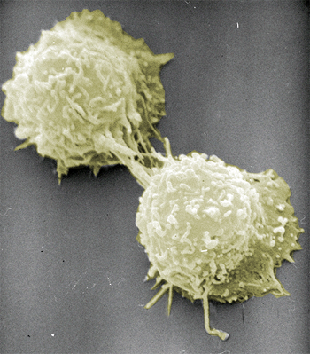
cell theory basics
All living things are composed of cells and cell products.
New cells are formed only by the division of preexisting cells.
A cell contains the inherited information (genes) used as the instructions for growth, functioning, and development.
The cell is the functioning unit of life; all of the chemical reactions of life take place within cells.
Cells make up living things
➙
New cells form by division

Slide 4

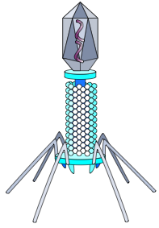
CELL SIZE
Most cells are between 1 and 100µm and visible only using a microscope.
Note: 1m = 1 000 000 micrometers!
Cell size is very diverse, a range of cells is shown below to illustrate this.
A virus (a non-cellular particle) is included for comparison.
.
White Blood Cell
Size: typically 10-15 µm
Bacterial Cell
Size: typically 2-10 µm
Viruses
Size: 0.02-0.25 µm

Slide 5
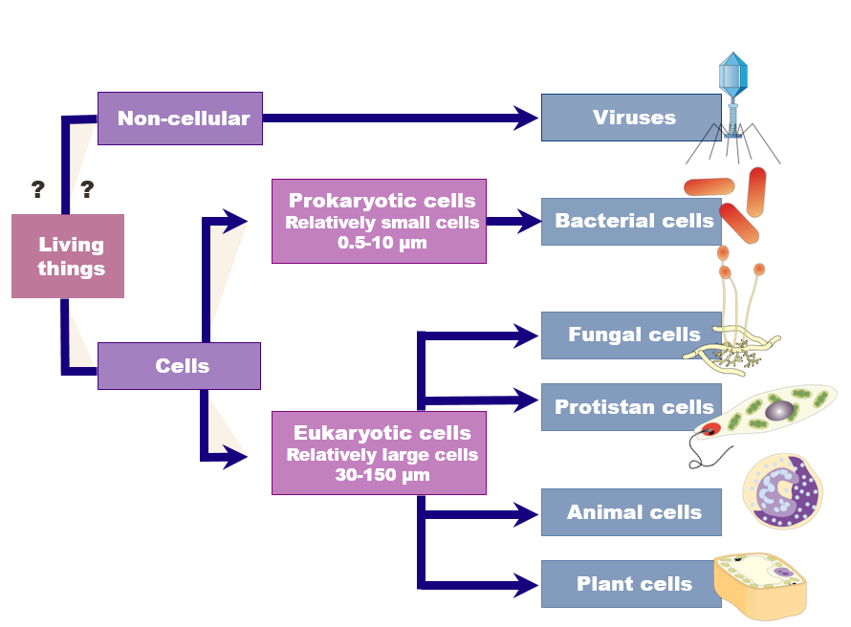
Fundamental classifications
The division of living organisms into prokaryotes and eukaryotes is a fundamental classification division.

Slide 6
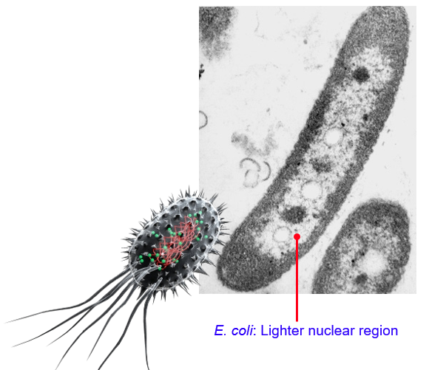
prokaryotes
Prokaryotic cells have no true nucleus.
Their genetic material is found a region called the nuclear area, but is not separated from the other cell material by a membrane.
Prokaryotic cells are generally smaller than eukaryotic cells.
Prokaryotes are unicellular organisms.
Bacteria are prokaryotes.

Slide 7
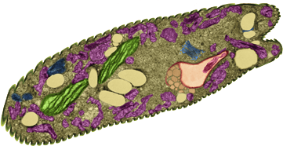
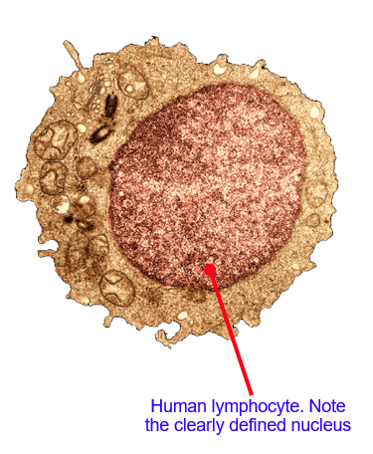
eukaryotes
Unicellular eukaryote, Euglena (protist)
Eukaryotes are characterized by having their genetic material contained within a nuclear membrane.
Eukaryotic cells are generally much larger than prokaryotic cells.
Eukaryotic cells can be unicellular or multicellular.
They are more complex cellular organisms and have a variety of internal membranes and structures, called organelles.
Fungi, protistians, animals, and plants are all eukaryotic.

Slide 8
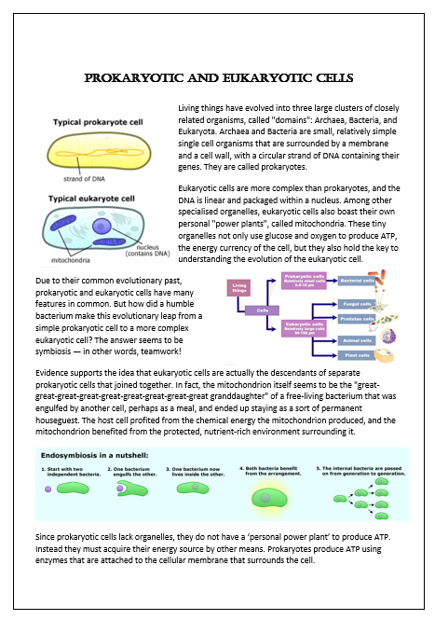
Venn Diagram Activity
Read the handout and construct a Venn Diagram to compare prokaryotic and eukaryotic cells.

